Slide 1
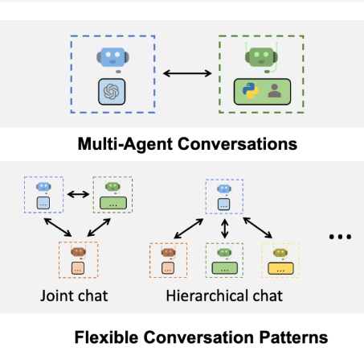

Autonomous Agents
Thaer Saidi

Slide 2
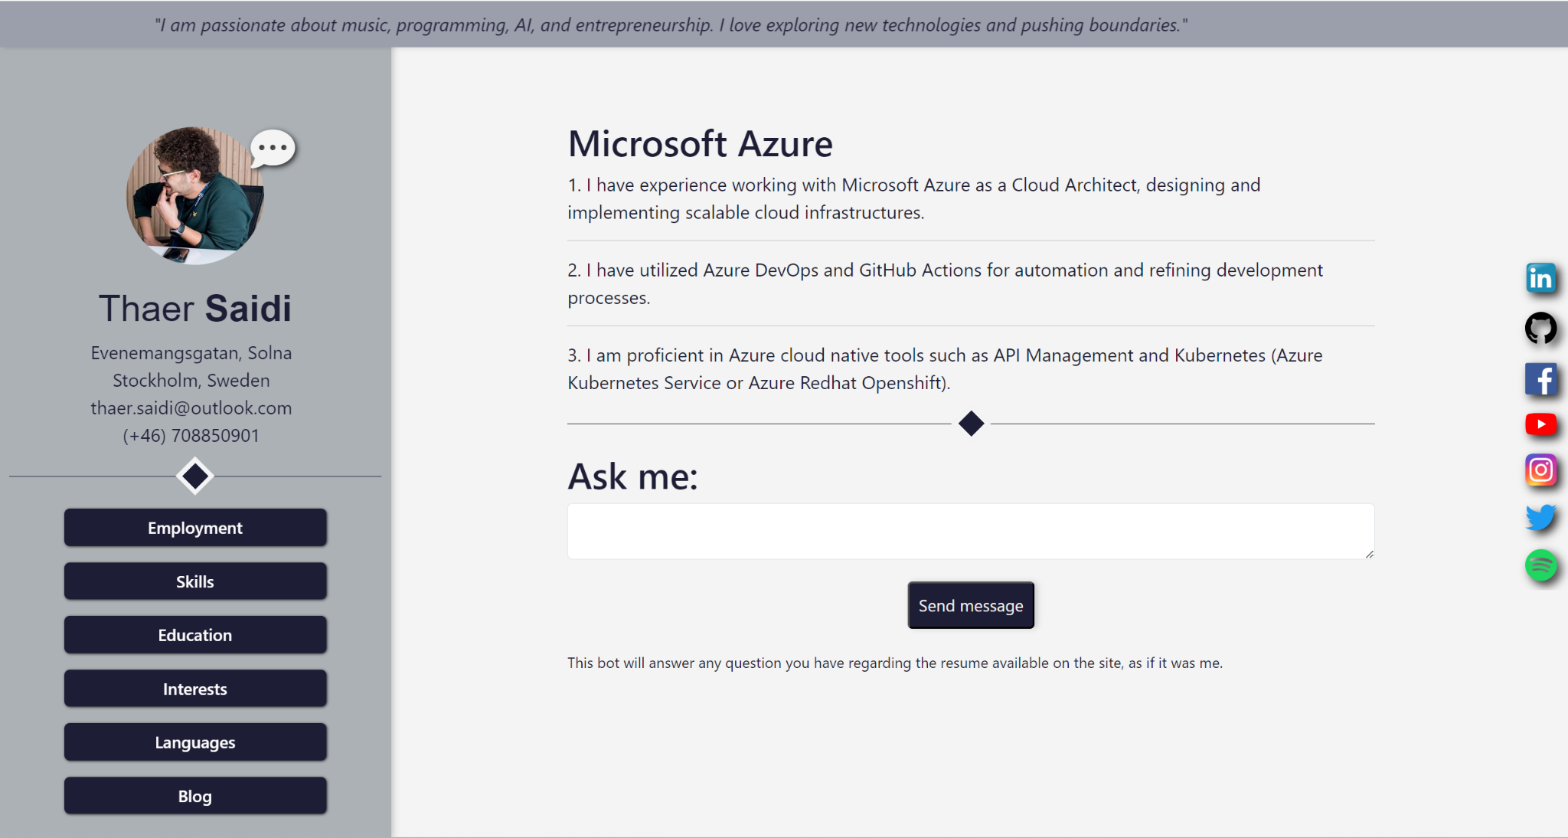
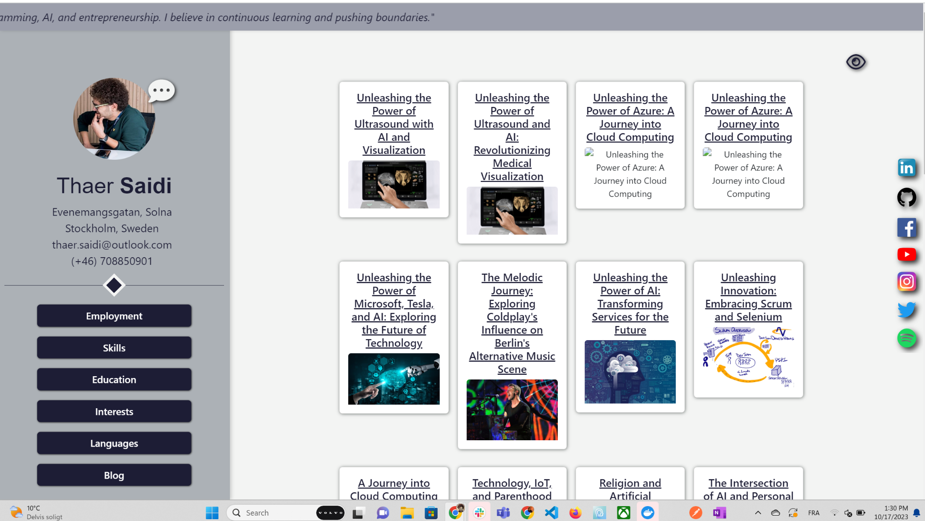
It all started with me adding a chatbot to my personal website.
Then I said why make one, let’s make many
Quotes
Skills
Messages
Blogs
Personal
Console: https://site-generator-ng.web.app
Website: https://log-book-ng.web.app
Of course they are tracked, monitored and seo’ed on:
Console: https://console.thaersaidi.net
Website: https://thaersaidi.net

Slide 3
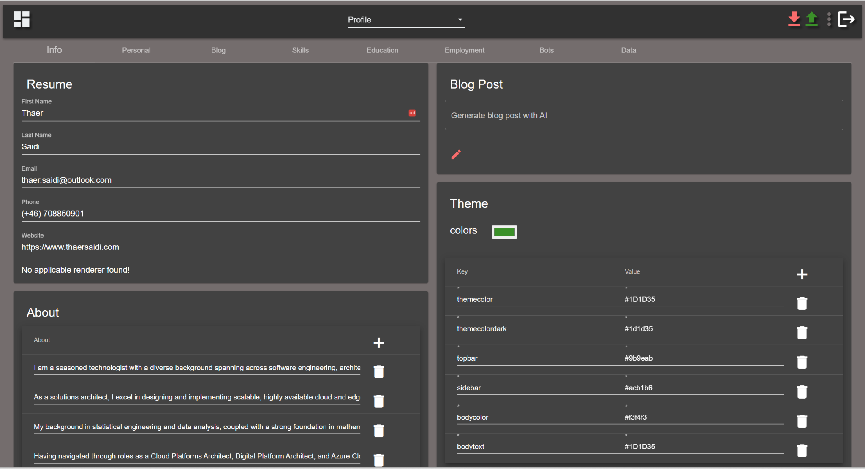
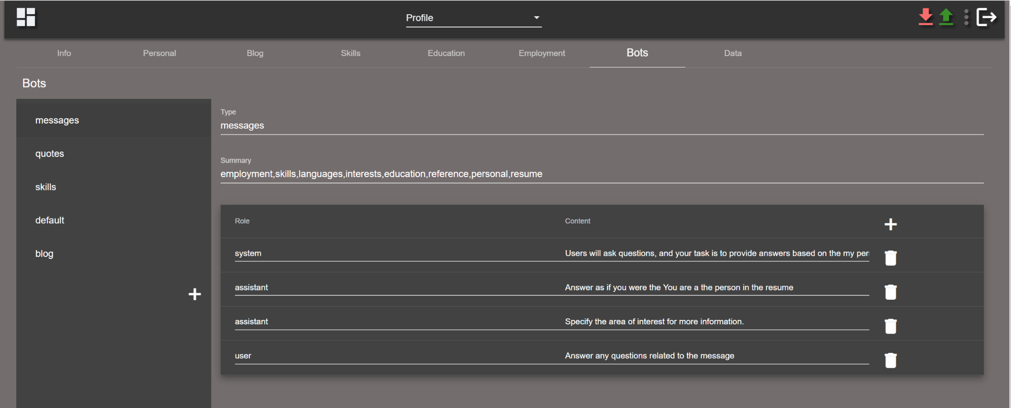
Then I said why only for my profile data, why not for anyone who registers. In this console anyone can get his profile data updated and then bots can be created and customized for different usecases and tasks.

Slide 4
In the "messages bot" example using RAG:
We provide the bot with essential data by highlighting key objects and terms from the profile information.
We set guidelines using a system message to dictate specific behaviors.
The AI model, or "assistant" and end user to add extra context to the request.

Slide 5
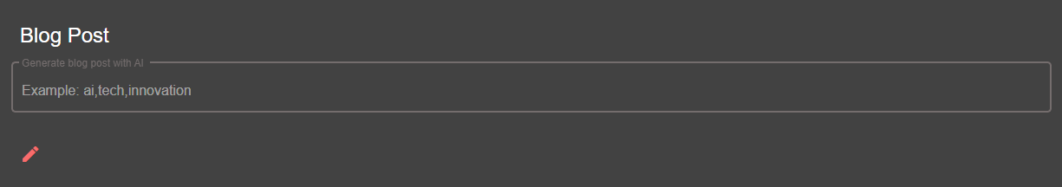
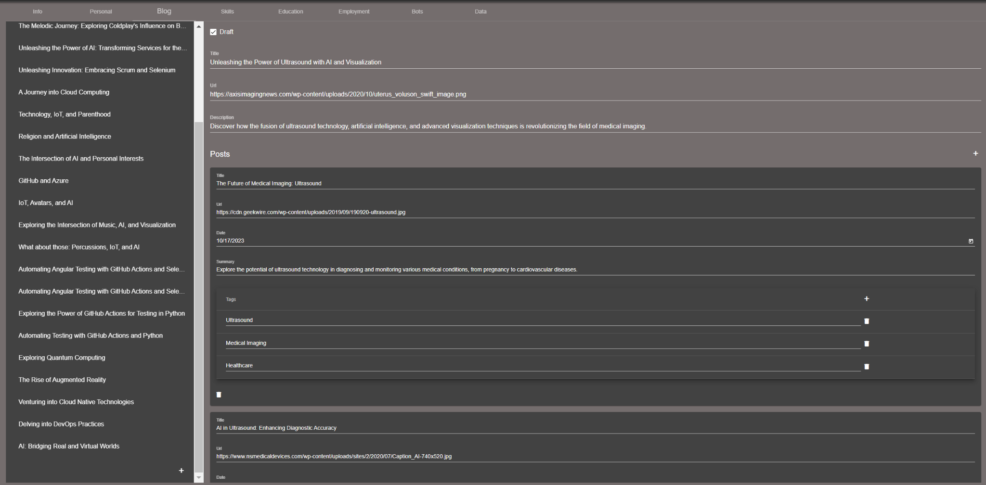
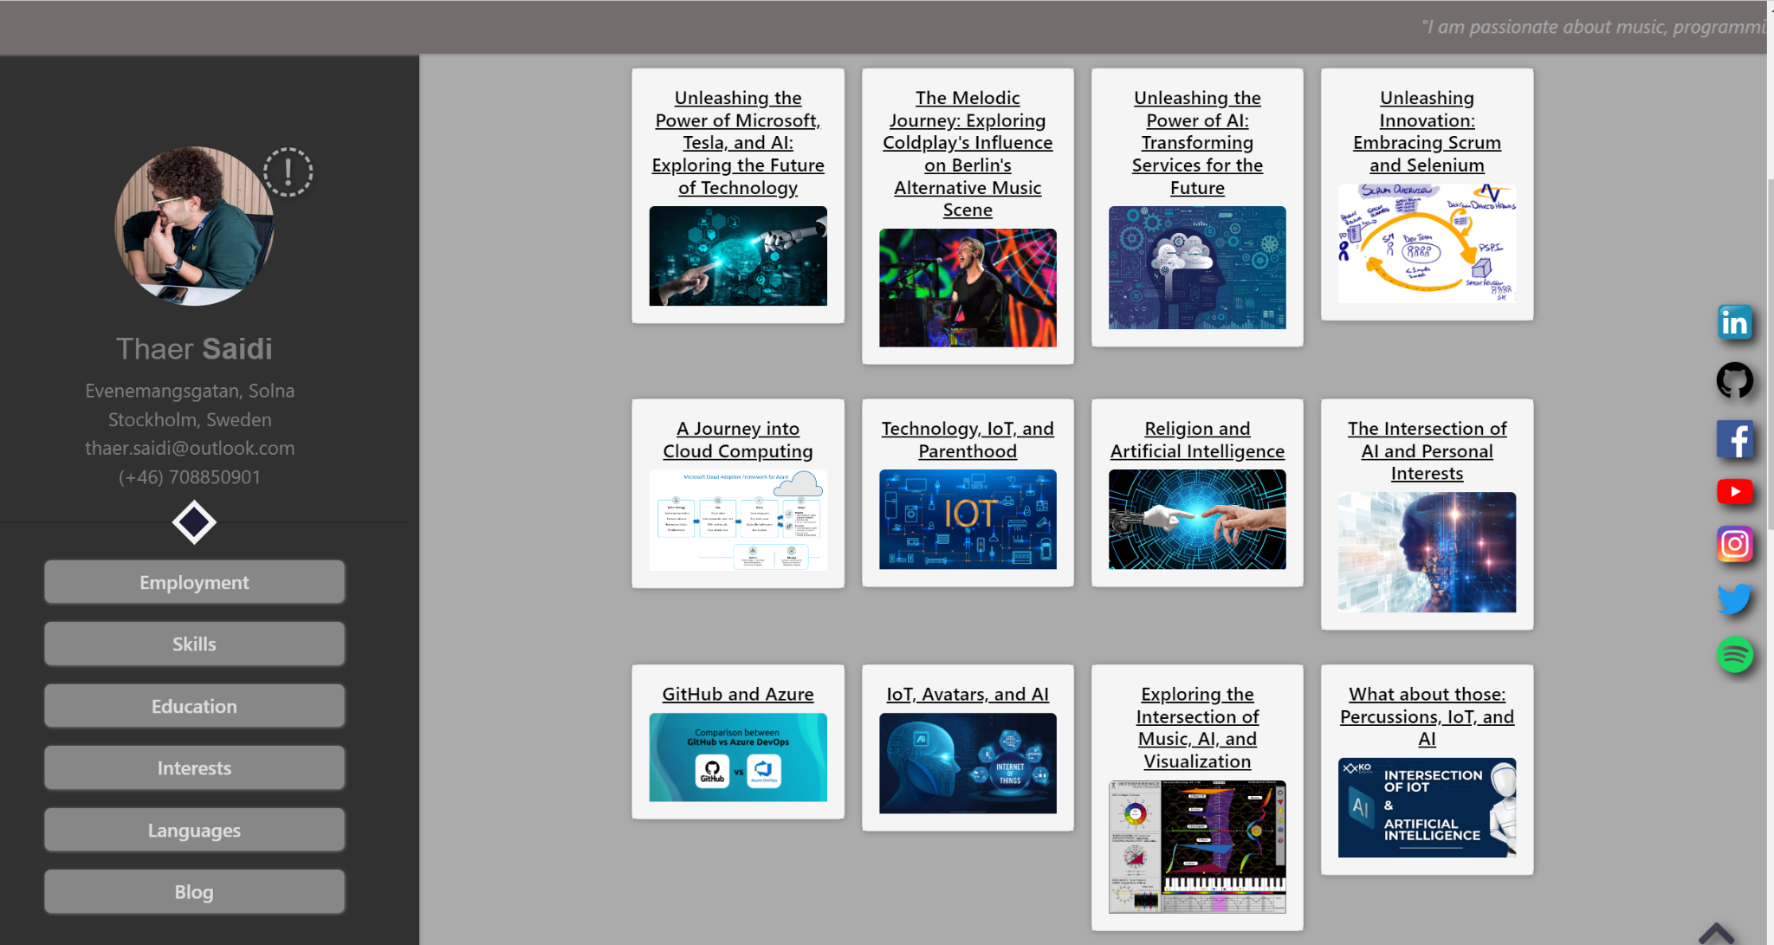
Then I said why shouldn’t the bots collaborate together and do a task.
So it started with this: Chatgpt Functions to call Bing and write blog posts and then enhance them with images

Slide 6
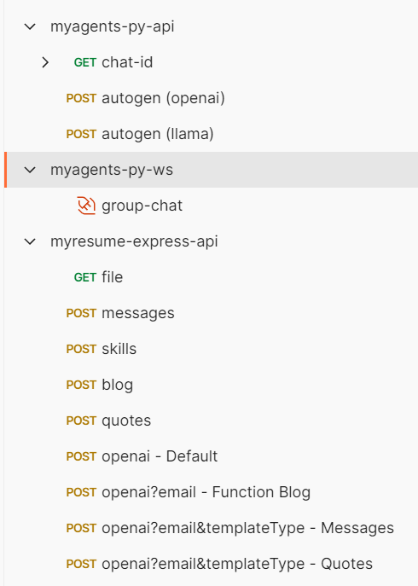








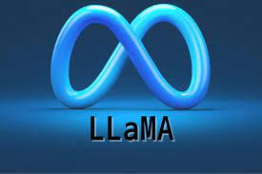


Here are the endpoints that are currently used.
Technologies used for the 2 sites and 2 microservices.

Slide 7
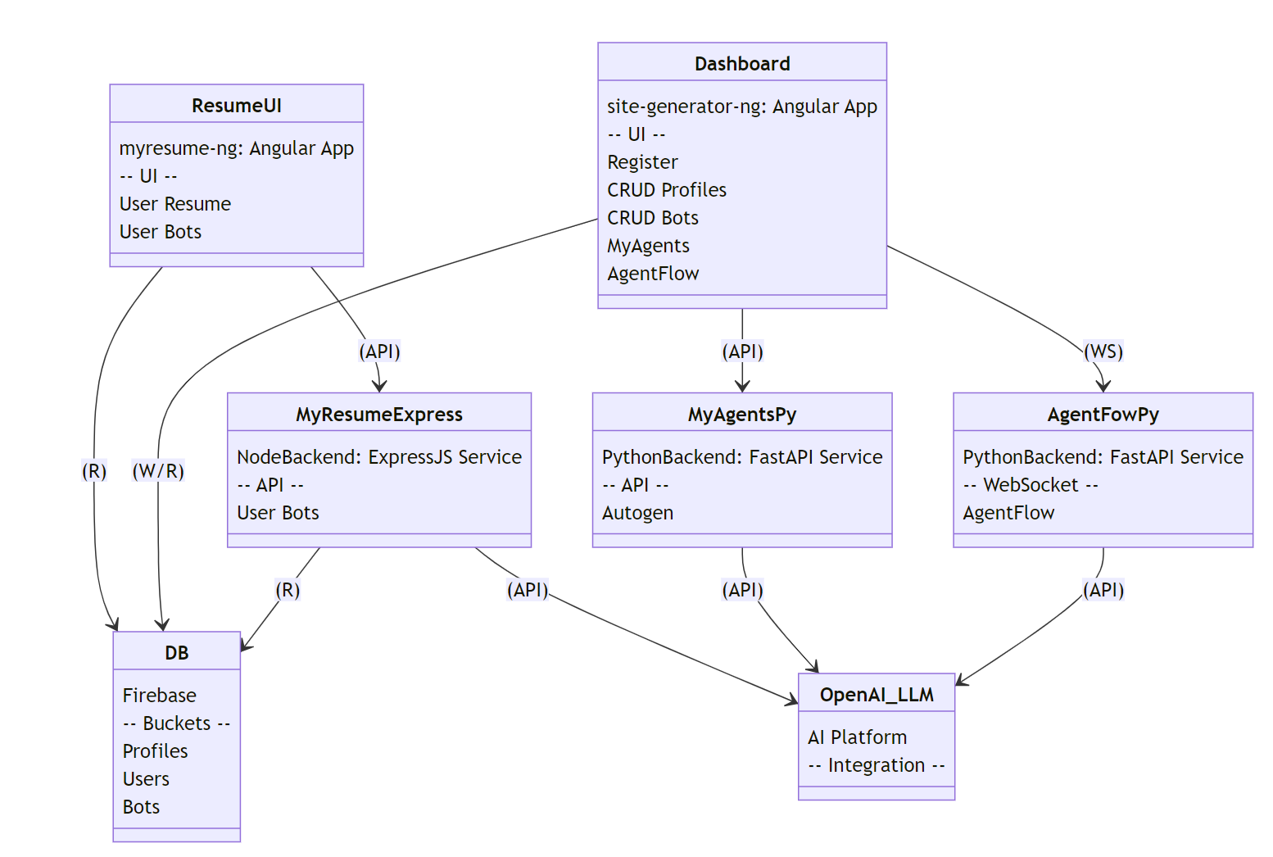
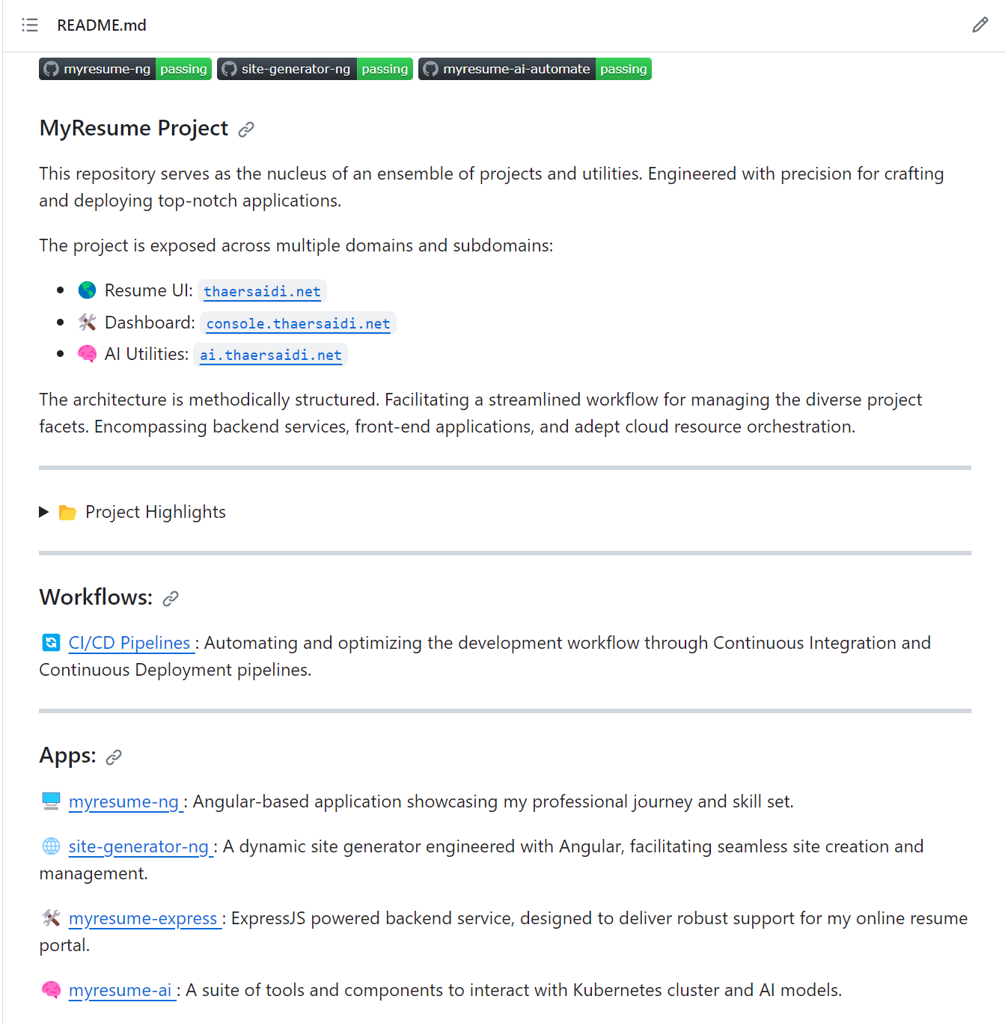
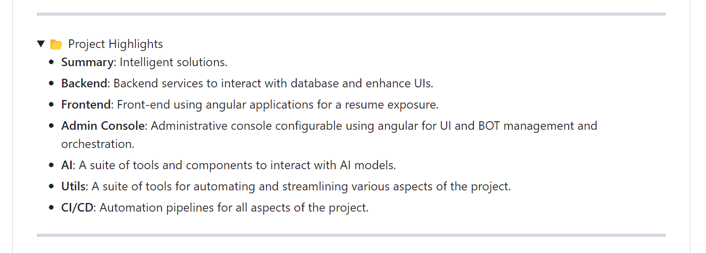
Thaersaidi.net Github Project:

Slide 8
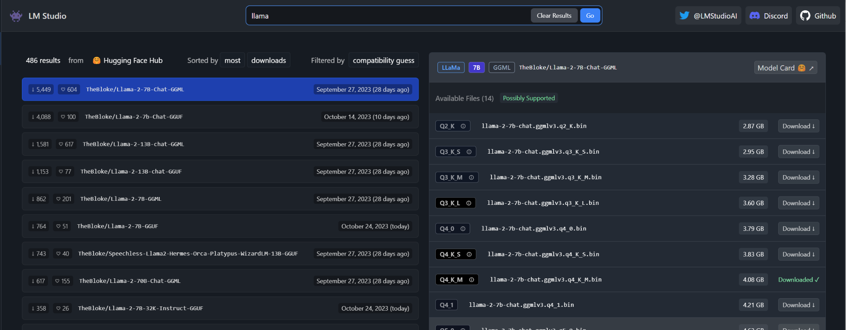
Now I use chatGPT mostly gpt-3.5-turbo but sometimes gpt-4
However, locally we can use any LLM using LM Studio, that can run a server and expose an openai like endpoints for chat and completion.

Slide 9
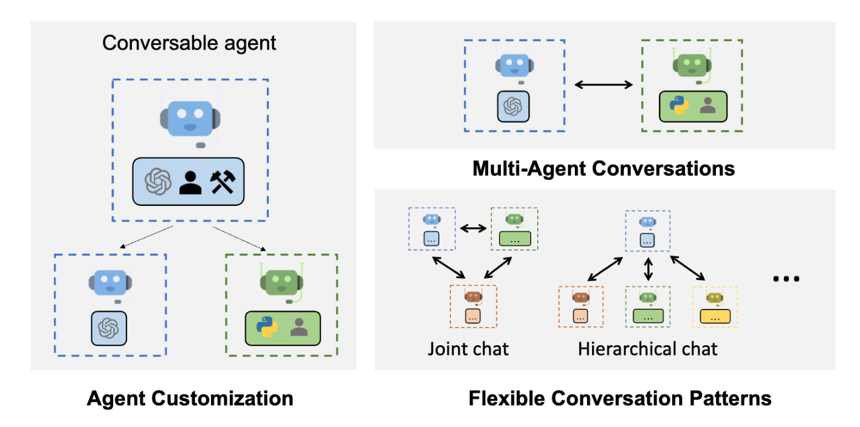
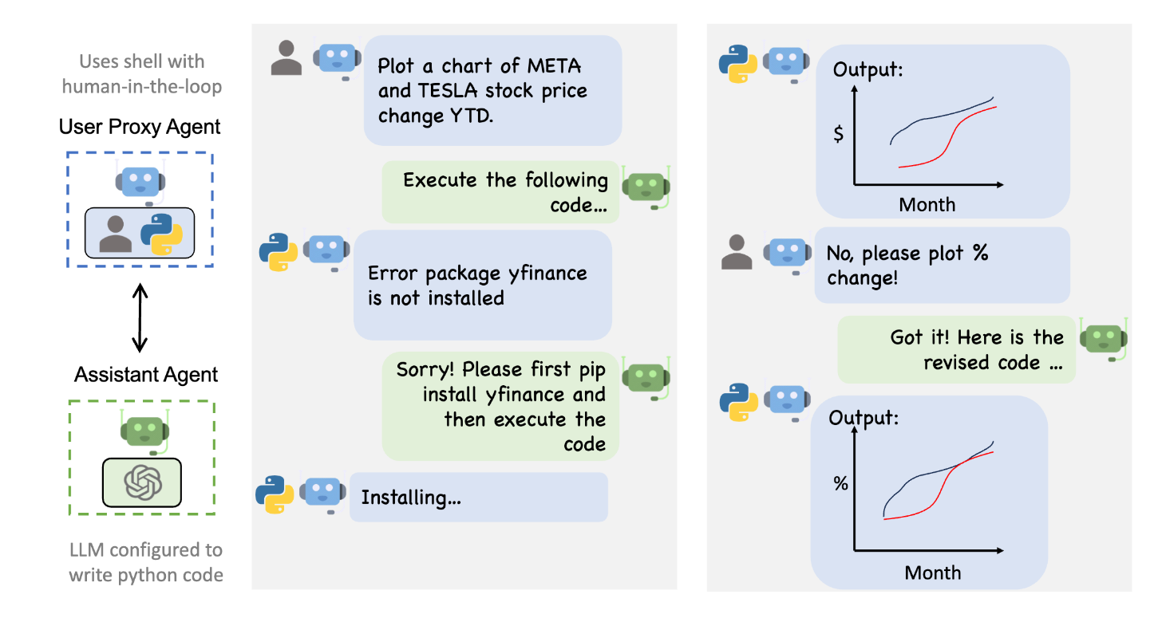
But then, Autogen:
A framework that enables development of LLM applications using multiple agents that can converse with each other to solve tasks.
AutoGen agents are customizable, conversable, and seamlessly allow human participation. They can operate in various modes that employ combinations of LLMs, human inputs, and tools.

Slide 10
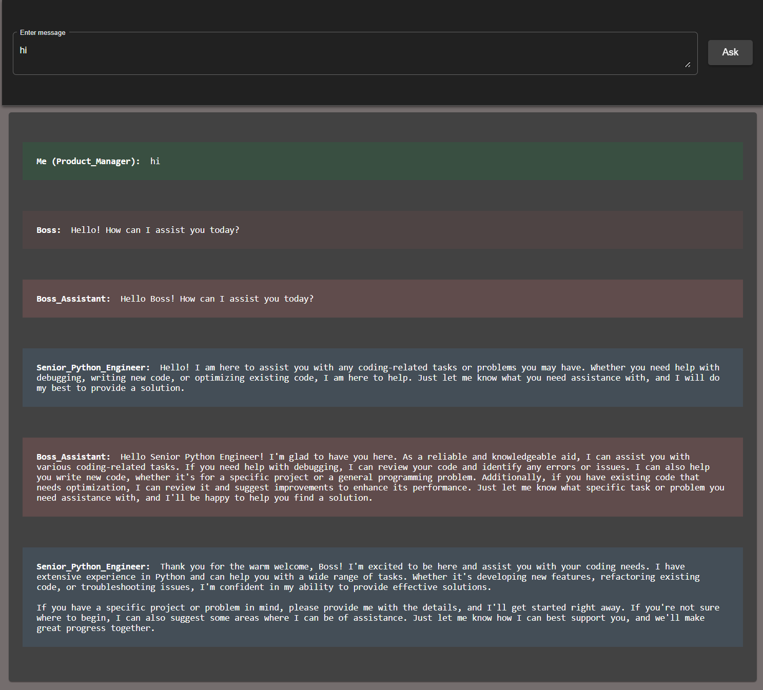
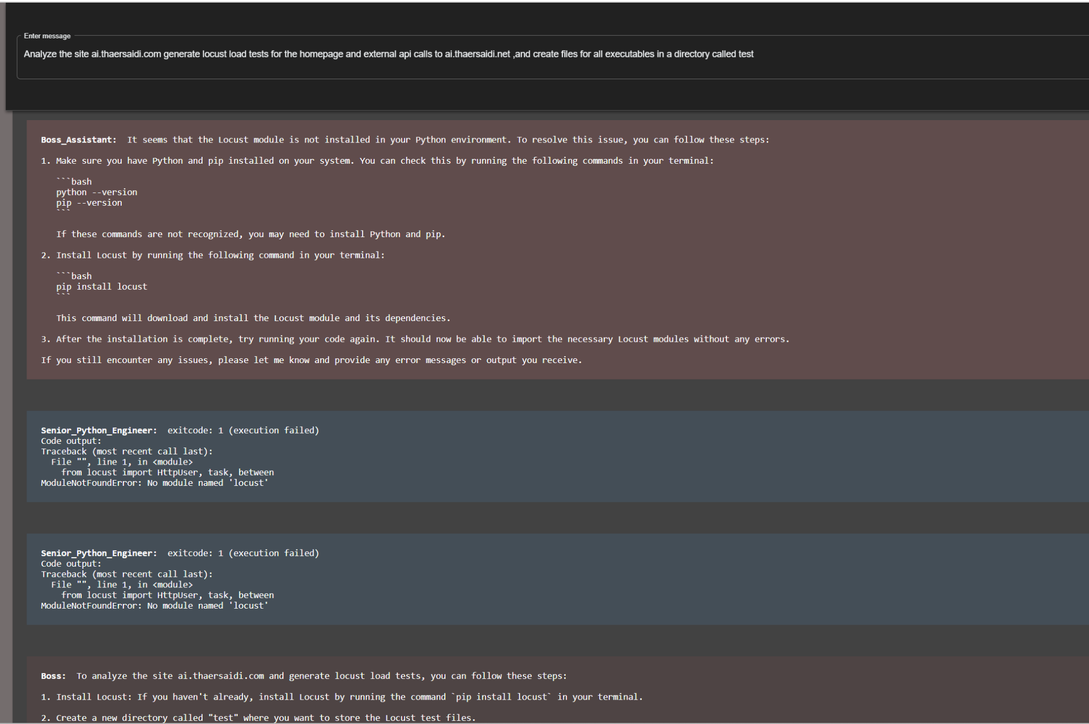
MemGPT and SPR

Slide 11
The team:
Basically we have a group chat containing the team that you see here.
Then we have a group manager (PM) which is the initiator of the chat.
Boss:
- An experienced tech leader with a vision to drive innovation and excellence. Creative in software product ideas, with a deep understanding of market needs
- Can execute and interpret code
Boss_Assistant:
-A reliable and knowledgeable aid with a knack for problem-solving. Detail-oriented reviewer ensuring code quality and functionality.
Senior_Python_Developer
- A highly skilled coder with the ability to translate complex problems into executable code.
- Can execute and interpret code

Slide 12
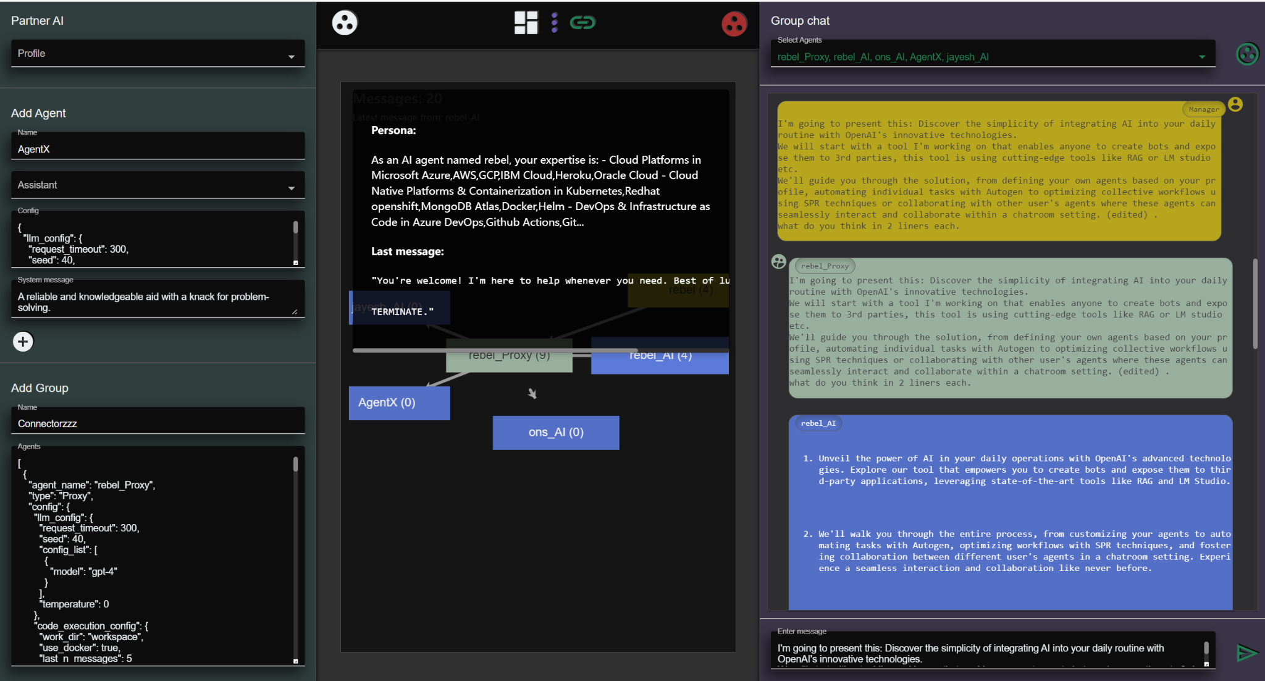
AgentFlow/Chatroom

Slide 13
Extra/Demo

Slide 14
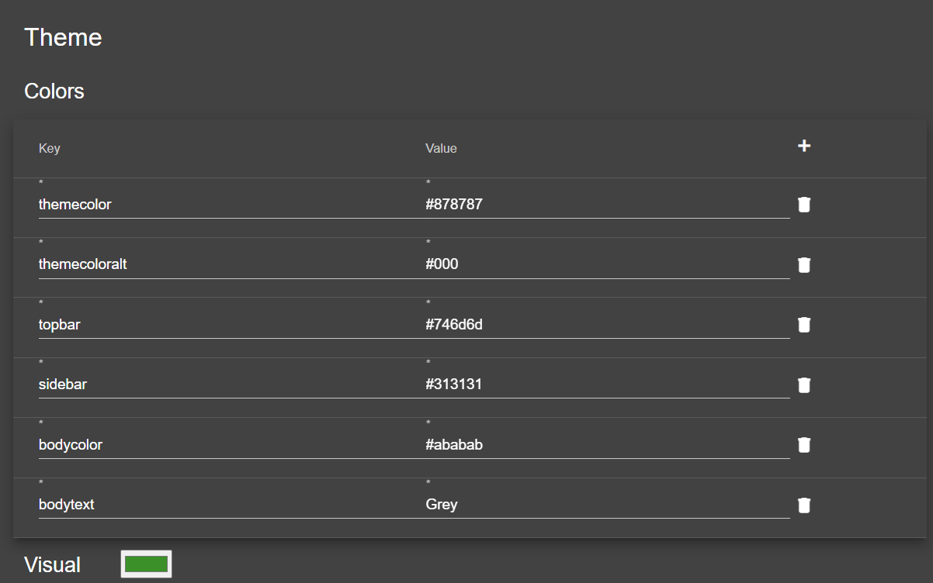
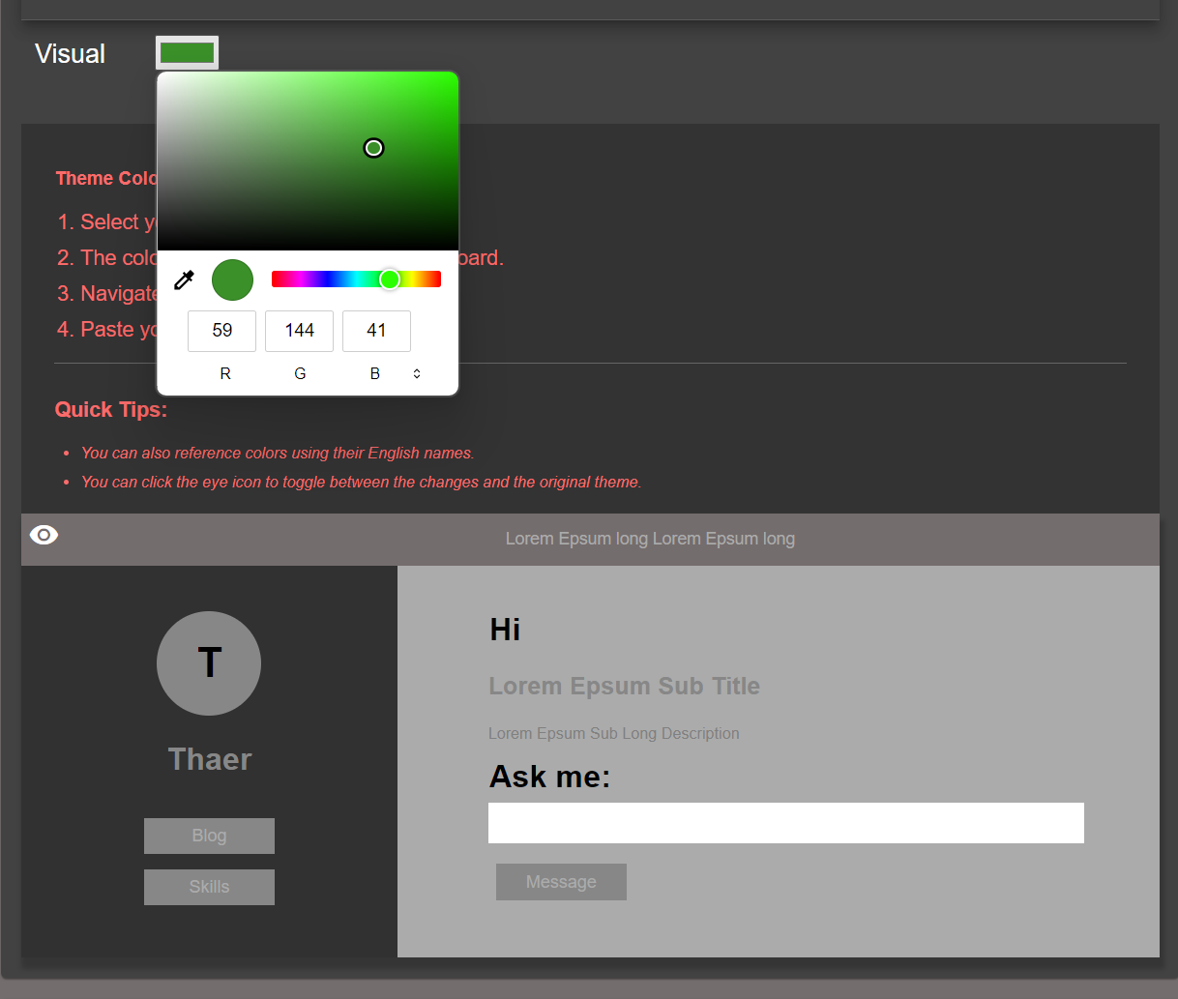
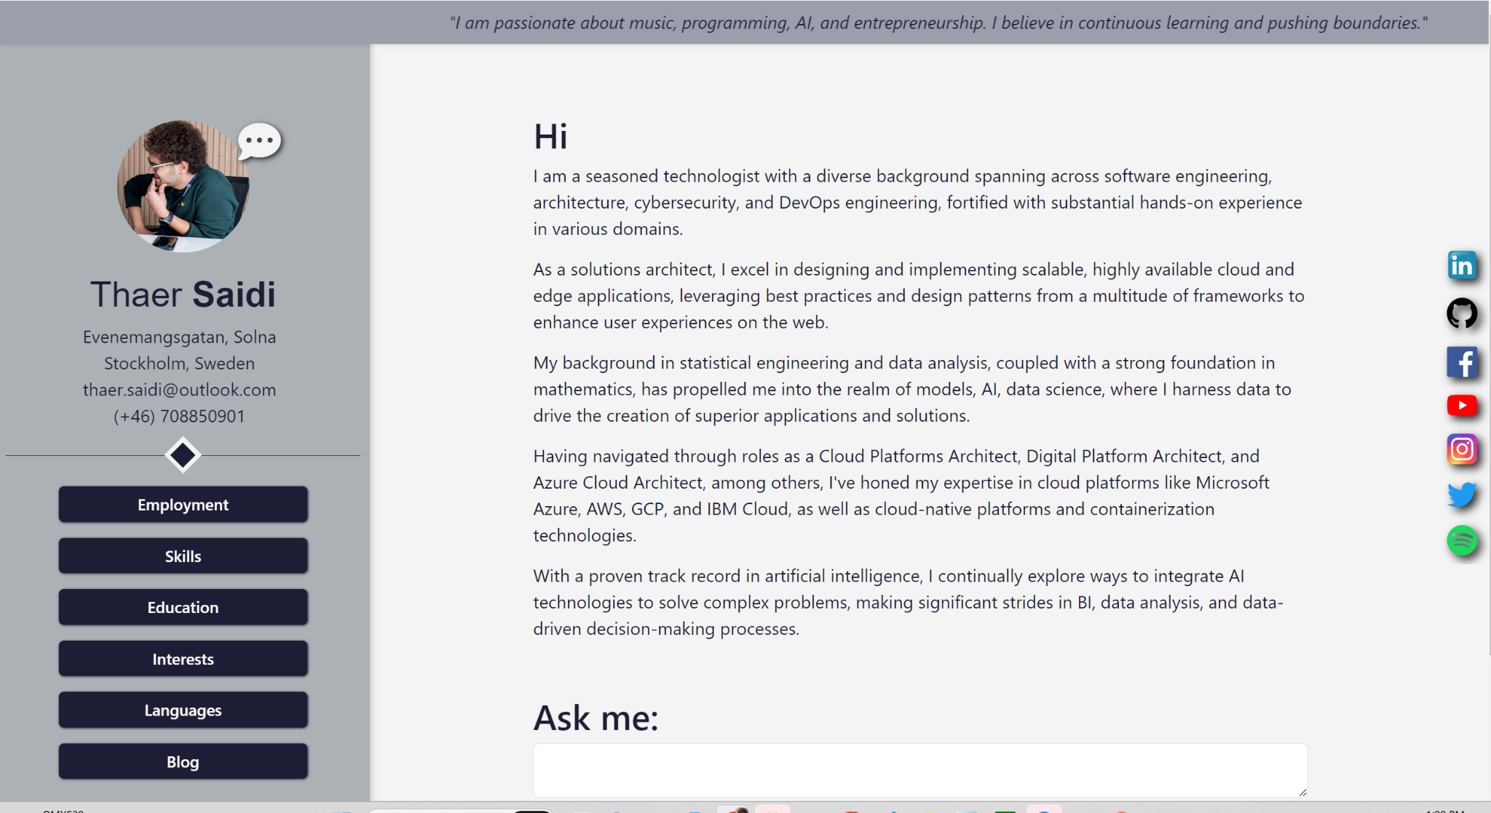
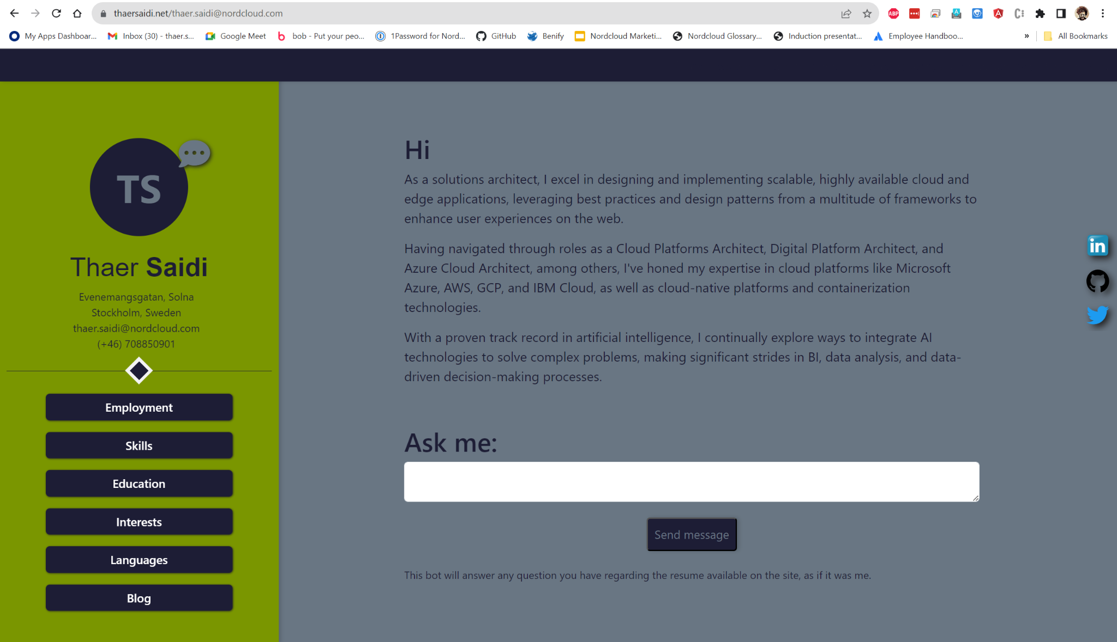
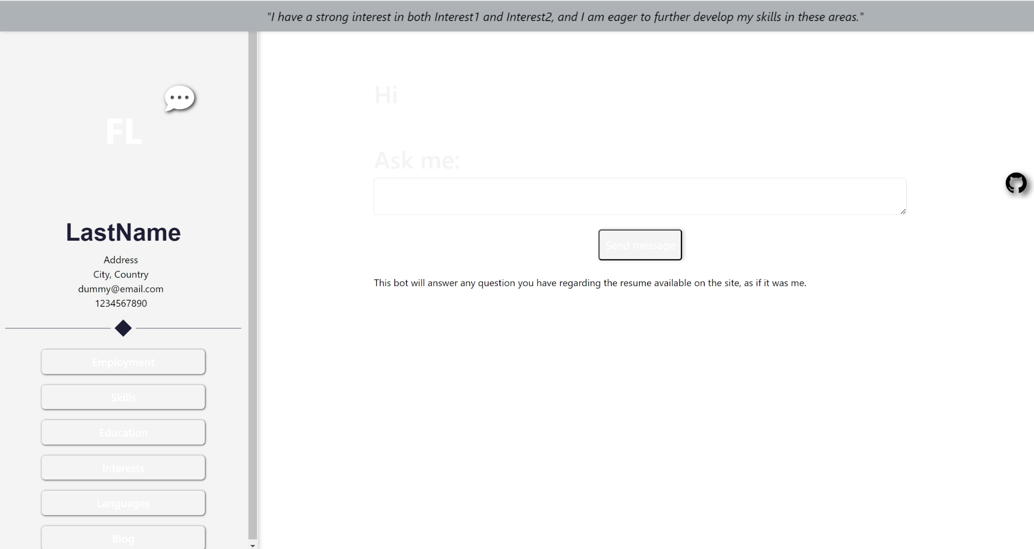
But then for fun, I added this:
A customizable theme for all users

